Slide 1
Hyperlink Presentation Template
For Use With The “Web & Internet Concepts”
Assignment

Slide 2
Table of Contents
Some Useful Documentation
Some Basic Concepts
Web Servers & Web Pages
Domain Names & IP Addresses
Mail Servers & Other Types of Servers
Network Routing & ISPs
Local Area & Wide Area Networks & VPNs

Slide 3


Some Useful Documentation
https://www.ispringsolutions.com/blog/user-guide-for-non-linear-presentations
Home

Slide 4
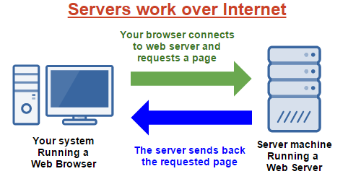

Some Basic Concepts
Client Server Model
Peer-To-Peer Model
Hyperlinks
Packets & Data
Firewalls
Basic Concepts
Home

Slide 5
Client Server Model
Explain the Client Server Model
What is the Client
What is the Server
Provide an example of an application that uses the Client Server Model
Basic Concepts
Home

Slide 6
Peer-To-Peer Model
Explain the Peer-To-Peer Model
What is a Peer
How is it different from a Client Server Model
Provide an example of an application that uses the Peer-To-Peer Model
Basic Concepts
Home

Slide 7
Hyperlinks
What is a Hyperlink?
How are Hyperlink related to Web Pages?
How are Hyperlinks related to this PowerPoint document?
Basic Concepts
Home

Slide 8
Packets & Data
What is a Packet?
Basic Concepts
Home

Slide 9
Firewalls
What is a Packet?
Basic Concepts
Home

Slide 10

Web Servers & Web Pages
HTML
Browsing A Web Page
Web Client Software
Web Server Software
Web Server Hardware
Web Servers
Home

Slide 11

Domain Names & IP Addresses
What is a Domain Name?
What is an IP Address?
How are Domain Names & IP Addresses related?
Who owns & controls the assignment of Names & Addresses?
How can I register a Domain Name for my own use?
Domain Names
Home

Slide 12
Blank Slide
Contents
Home

Slide 13
Blank Slide
Contents
Home

